Slide 1
Group 93
Yosef Kelly
Benjamin Pister
Thomas Woudenberg

Slide 2
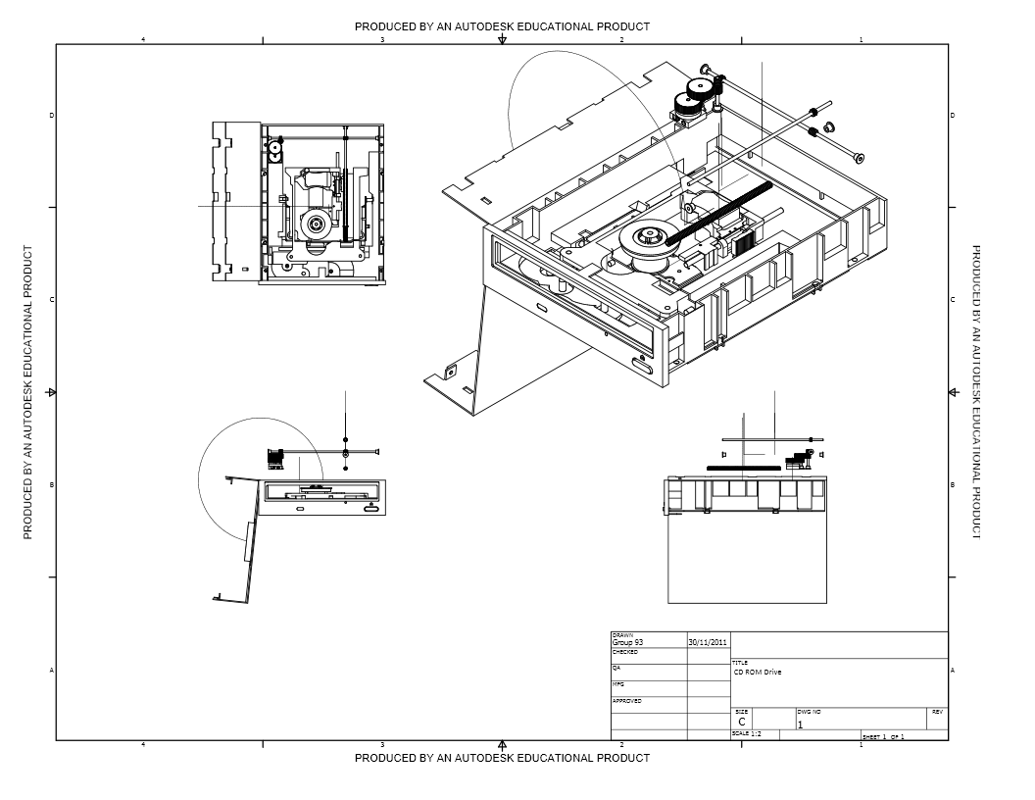

Slide 3
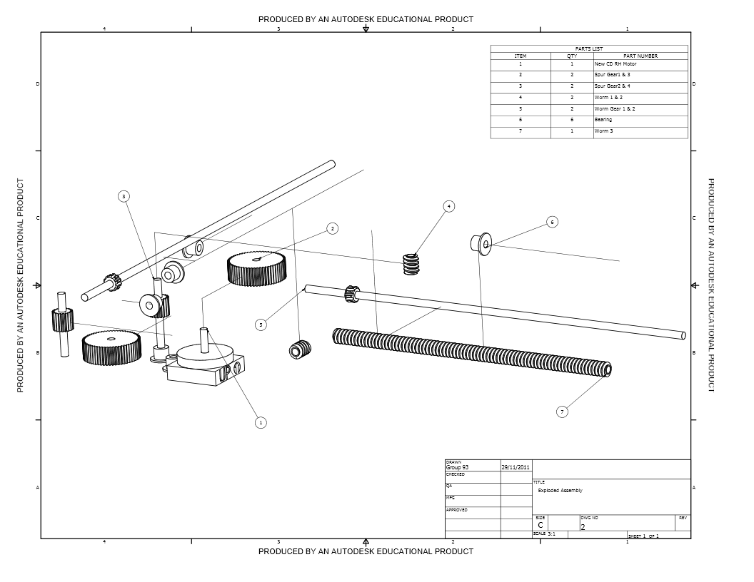

Slide 4
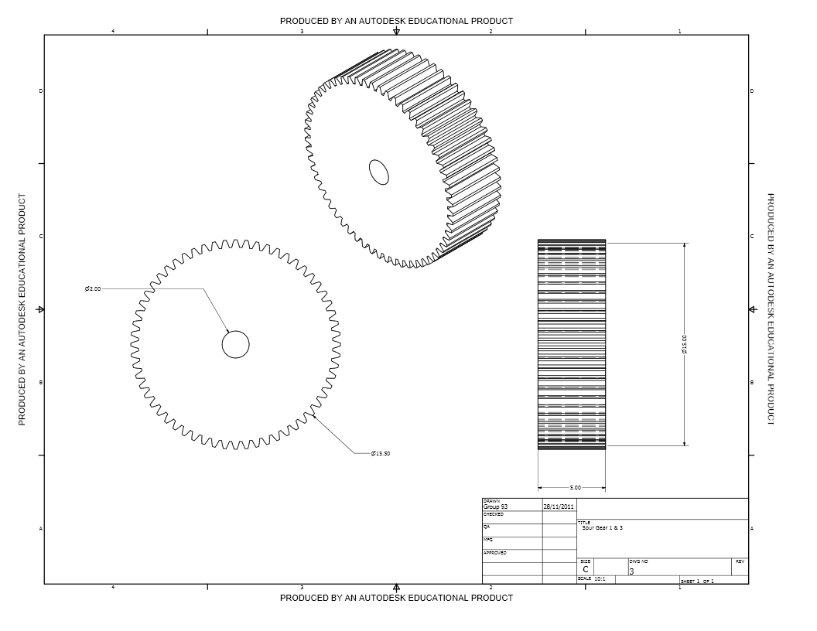
Gears 1 & 3
60 Teeth
Module: 0.25
Diameter: 15mm

Slide 5
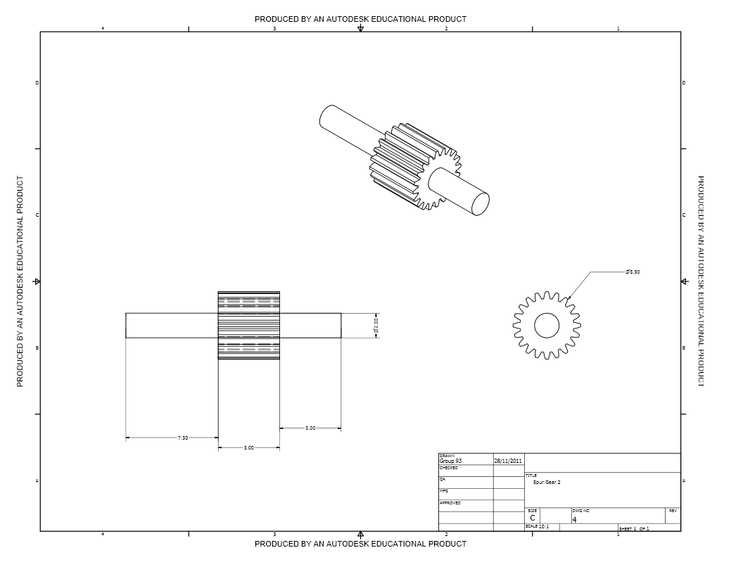
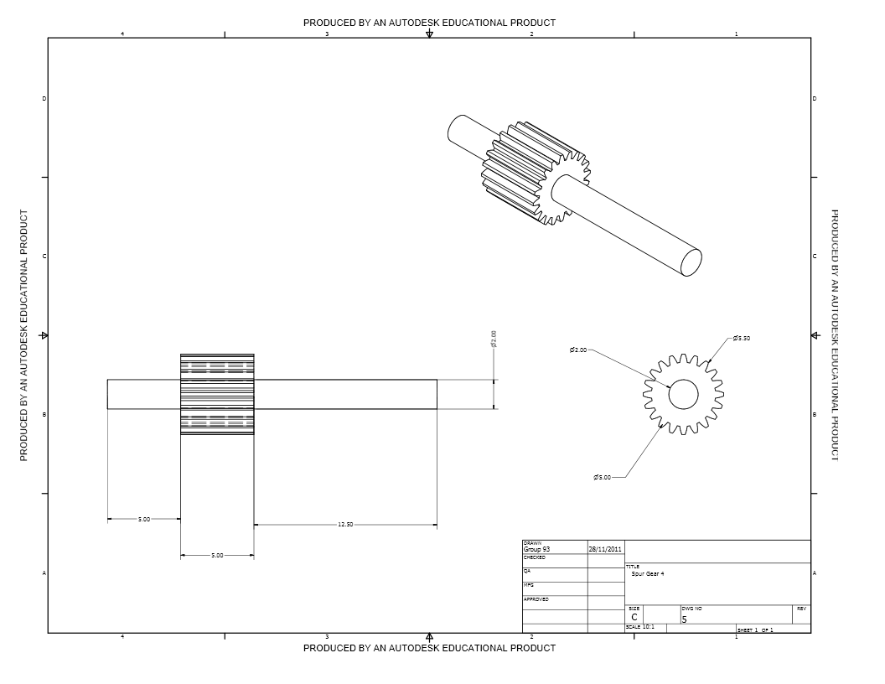
Gears 2 & 4
20 Teeth
Module: 0.25
Diameter: 5mm

Slide 6
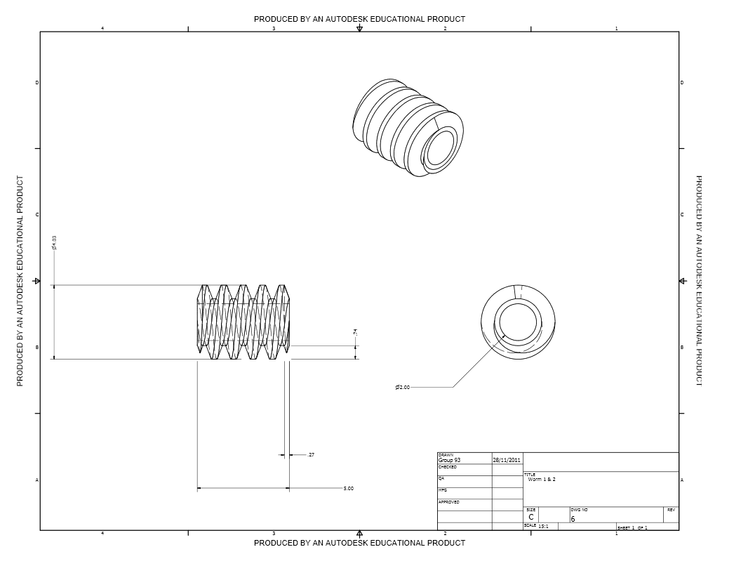
Worm Gear 1 & 2
Pitch: 1.054185115

Slide 7
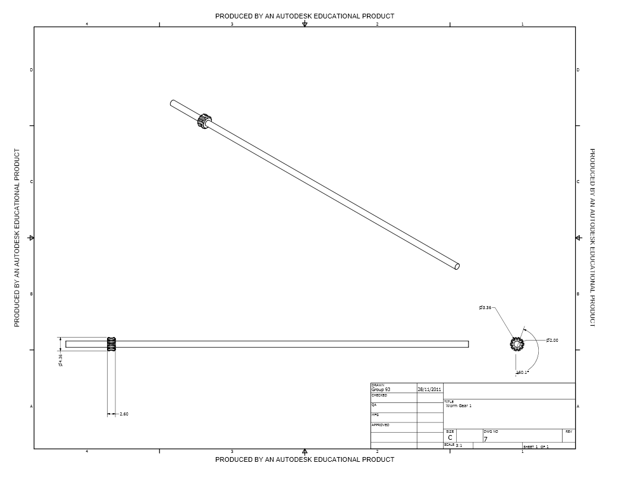
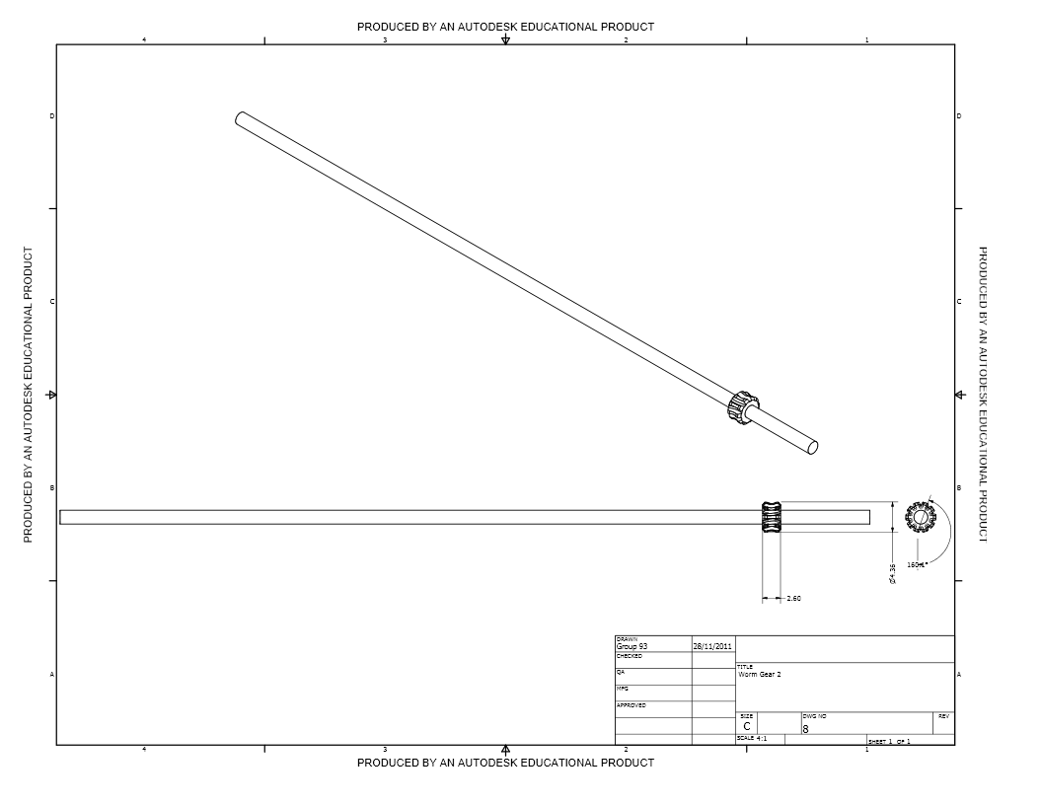
Spurs

Slide 8
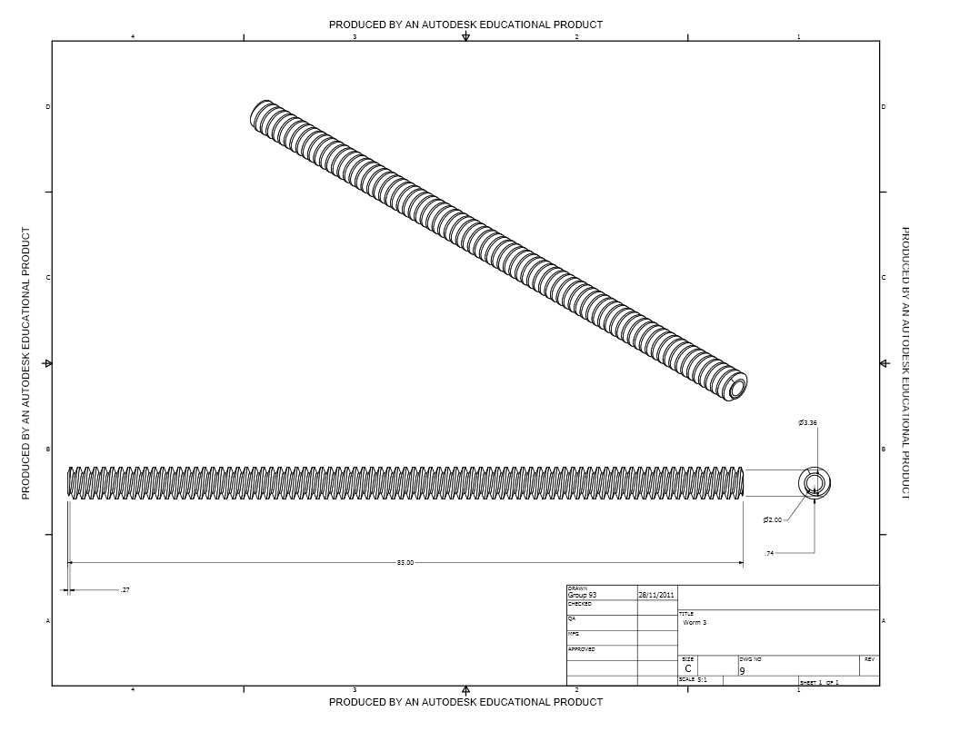
Worm

Slide 9
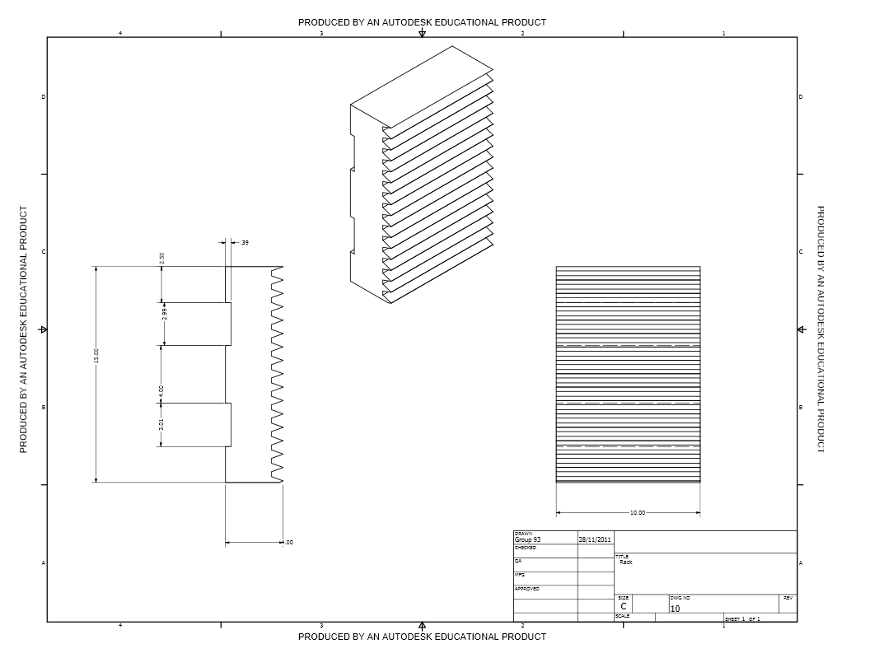
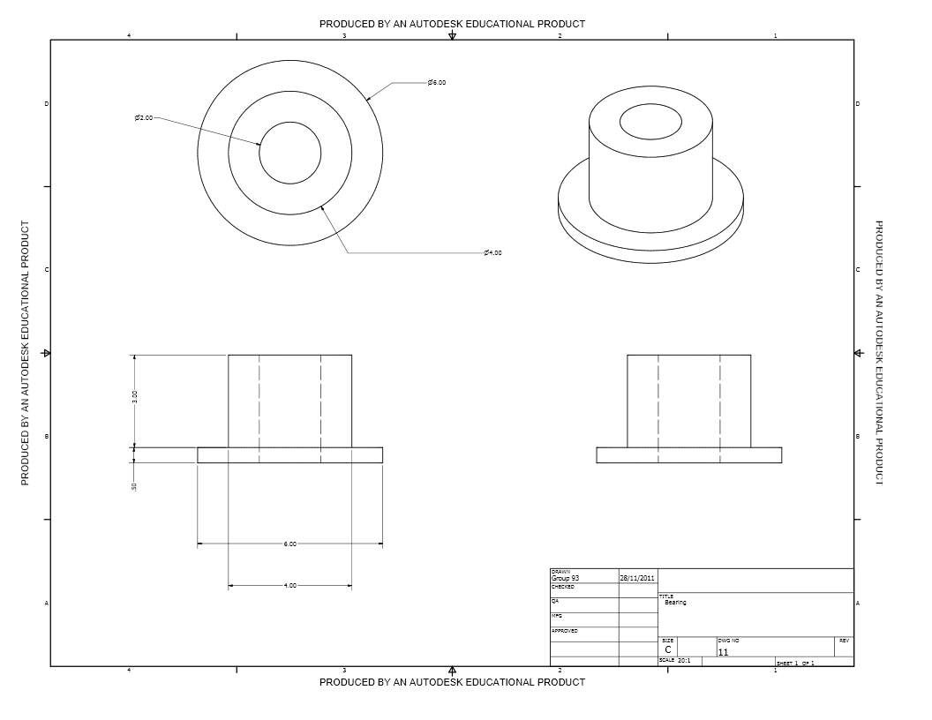
Bearing
Rack

Slide 10




Slide 11
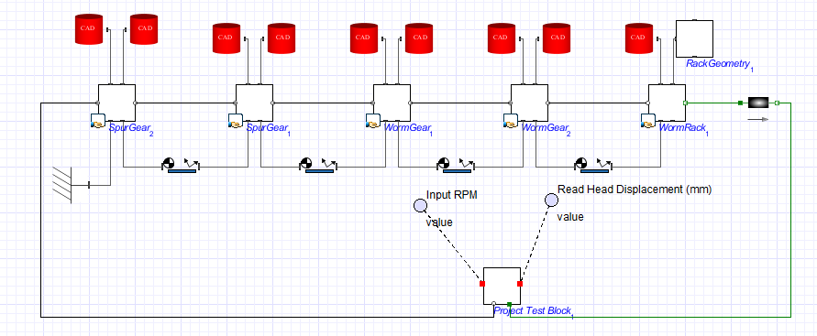
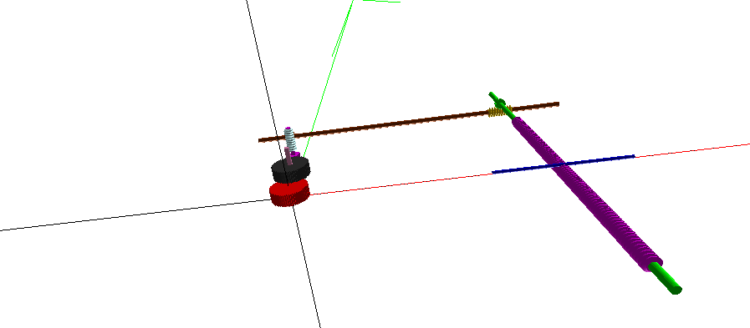

Slide 12
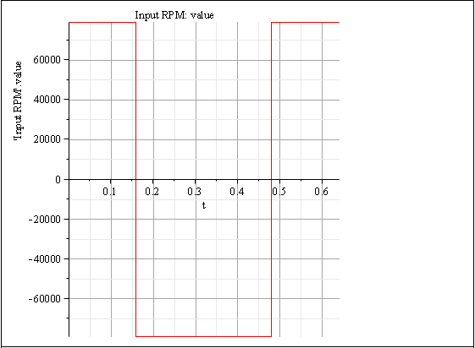
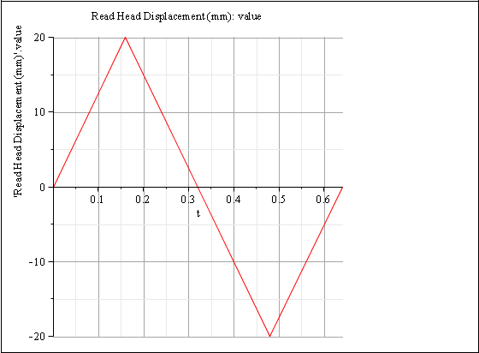

Slide 13
